Slide 1

Emissions
By
Mr. P Seetaramaraju V L Niladriraju
Mr. Himanshu Sachan
Mr. Pankaj Nagnath Salunke
Mr. Mhaske Shrikant Chandrakant
Mr. Chouhan Vilas Pandu

Slide 2
Content
Objective and Features Provided
Introduction to Dataset
EDA
Feature Engineering
Model Building
Results
Deployment
Streamlit App

Slide 3
Objective and Features Provided
Fundamental Goal of the Project is to build a Regression Model for prediction of CO2 Emissions of a Car based on the following Features.
Make:- Car brand under study.
model:- the specific model of the car.
Vehicle class:- car body type of the car.
Engine size:- size of the Car Engine, in Liters.
Cylinders:- number of cylinders.
Transmission:- "A" for ‘Automatic', "AM" for ‘Automated manual’, "AS" for 'Automatic with select shift’, "AV" for 'Continuously variable', "M" for 'Manual’.
Fuel type:- "X" for 'Regular gasoline', "Z" for 'Premium gasoline', "D" for 'Diesel’, "E" for 'Ethanol(E85)', "N" for 'Natural gas’.
Fuel consumption city:- City fuel consumption ratings, in liters per 100 kilometers.
Fuel consumption hwy:- Highway fuel consumption ratings, in liters per 100 kilometers.
Fuel consumption comb(l/100km):- the combined fuel consumption rating. (55% city, 45% highway), in L/100 km.
Fuel consumption comb(mpg):- the combined fuel consumption rating. (55% city, 45% highway),in miles per gallon (mpg).
Co2_emissions:- the tailpipe emissions of carbon dioxide for combined city and highway driving, In grams per Kilometer.

Slide 4
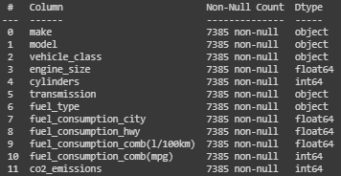
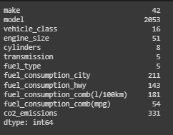
Introduction to Dataset
There are 12 features in total.
There are 7385 rows.
There are 5 Categorical Columns
1) Make
2) Model
3) Vehicle Class
4) Transmission
5) Fuel Type
There are 6 Non-Categorical Columns
1) Engine Size
2) No of Cylinders
3) Fuel Consumption City
4) Fuel Consumption Highway
5) Fuel Consumption combined(L/100km)
6) Fuel Consumption combined (MPG)
There are 1112 Duplicates present in dataset.
After removing the duplicates the number of unique values in each features are shown in adjacent features

Slide 5
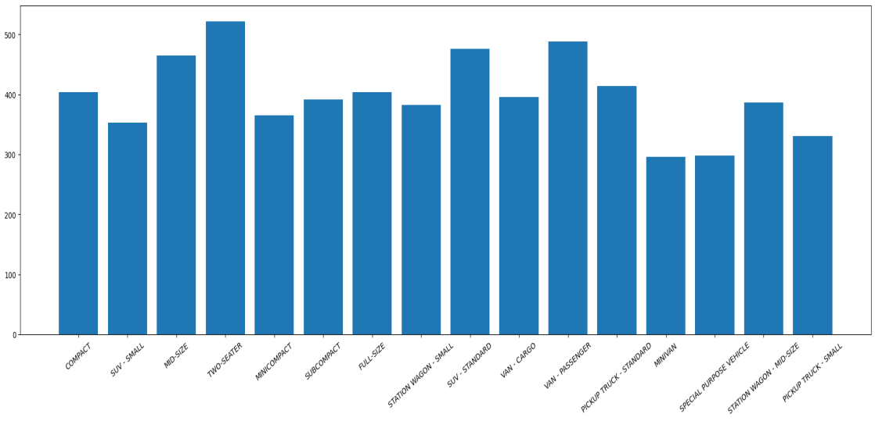
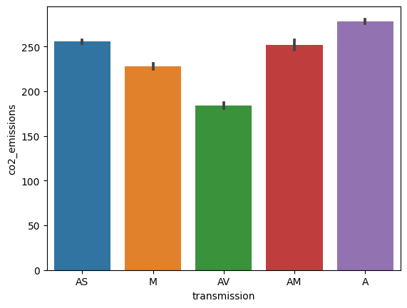
EDA
The Vehicle Class has a total of 16 Unique values and when compared with CO2 Emissions the each Vehicle class has different values or range of Emissions.
Transmission has 5 unique values in it and when compared with CO2 Emissions there are differences in the Emissions Quantity for every Transmission Type.

Slide 6
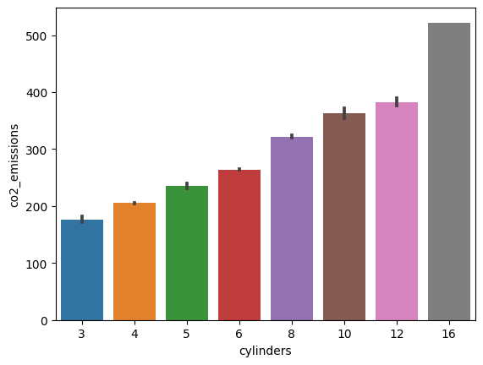
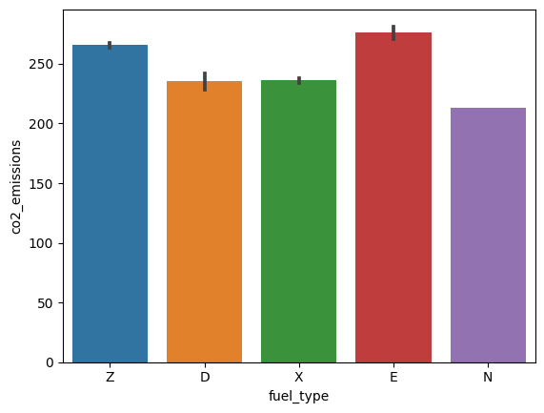
EDA Cont.
There are 8 unique Values in Cylinders and when plotted with CO2 Emissions, the emission quantity is increasing with increase in the number of cylinders.
There are 5 unique Fuel Types and when plotted with CO2 emission, the emissions are varying for each Fuel Type.

Slide 7
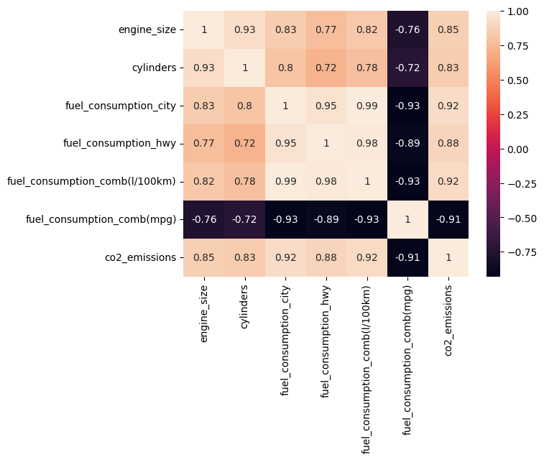
EDA Cont.
Heat Map with Correlation shows that correlation of the Numerical Features with respect to The Target Variable.
Fuel Consumption in City, Fuel Consumption in Highway, Fuel Consumption Combined City and Highway, Fuel Consumption Both (MPG) are highly correlating with each other.
Engine Size and No. of Cylinders are Highly correlating with each other.
(Fuel Consumption (MPG) is inversely proportional to the Target Variable. If the Fuel Consumption (MPG) increases then the Quantity of Emission decreases.)

Slide 8
Feature engineering
Anova test is performed to check if Categorical Features are Important for model building.
Anova test basically compares the means of more than 2 Columns and based on the output result we select if we consider the feature or not on the basis of Hypothesis Testing.
Ho= Null Hypothesis= Means are the same
H1= Means of at least one column is different in all the columns.
If P-Value is less than 0.05 in the Output Result then we accept Alternate Hypothesis and consider that Variable as an important Variable for Model Building.
The P-Values for the three Features are less than 0.05 so we are considering Make, Vehicle Class, Fuel Type and Transmission for Model Building.

Slide 9
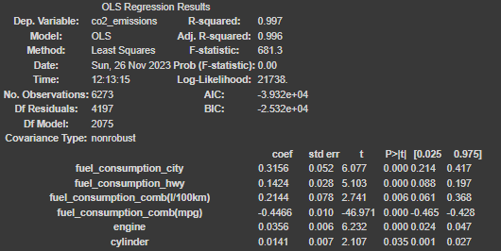
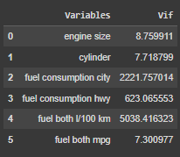

Feature Engineering Cont.
For Numerical Features OLS Regression method is used to see if the features are Important for the Model Building.
Based on the result all the Numerical Features have P-Value of 0.05 so all the features are considered
VIF is calculated to find the Multi-collinearity between Numerical Features.
After eliminating features with Multi-collinearity we are left with 2 numerical features that will be used for Model Building.
Features used for Model Building :- Vehicle Class, Cylinders, Transmission, Fuel Type, Fuel (MPG)

Slide 10
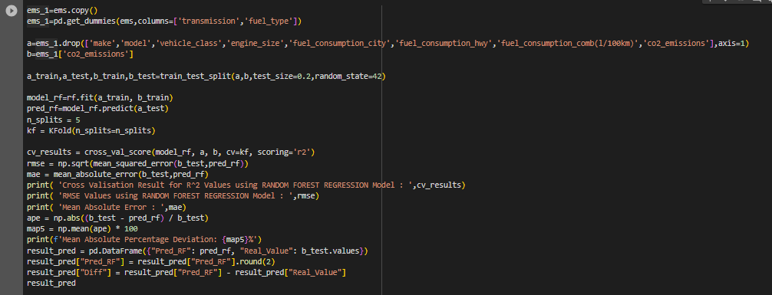
Model Building
Models Used For Model Building
1) Linear Regression
2) X G Boost
3) Random Forest
The following is the code for Random Forest without considering Vehicle Class.

Slide 11
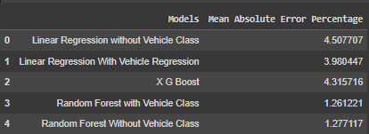
Results
The Mean Absolute Error Percentage describes the percentage of Difference between Predicted Values and Original Values.
Random Forest Regressor gives Best result for the prediction of CO2 Emissions.

Slide 12
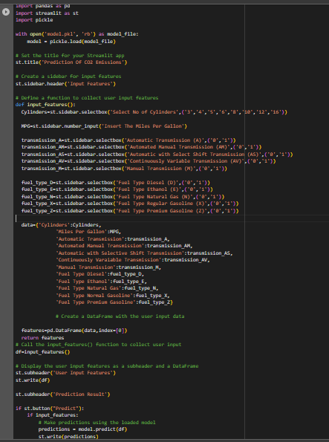
Deployment
Used Streamlit to create the app.
Imported the model as a Pickled File.
Installed a drop down box for selection of Number of Cylinders.
Installed Input Box to input the Miles Per Gallon.
Installed Drop Down Box for all Transmission and Fuel Type values individually setting Default as 0.
To select a Transmission or Fuel Type select the Drop Down Box and select 1 in the box.
Displayed a Table where the input Given is Displayed.
Model is run on the Table when Predict button is Clicked and the Prediction Appears on the Screen.

Slide 13
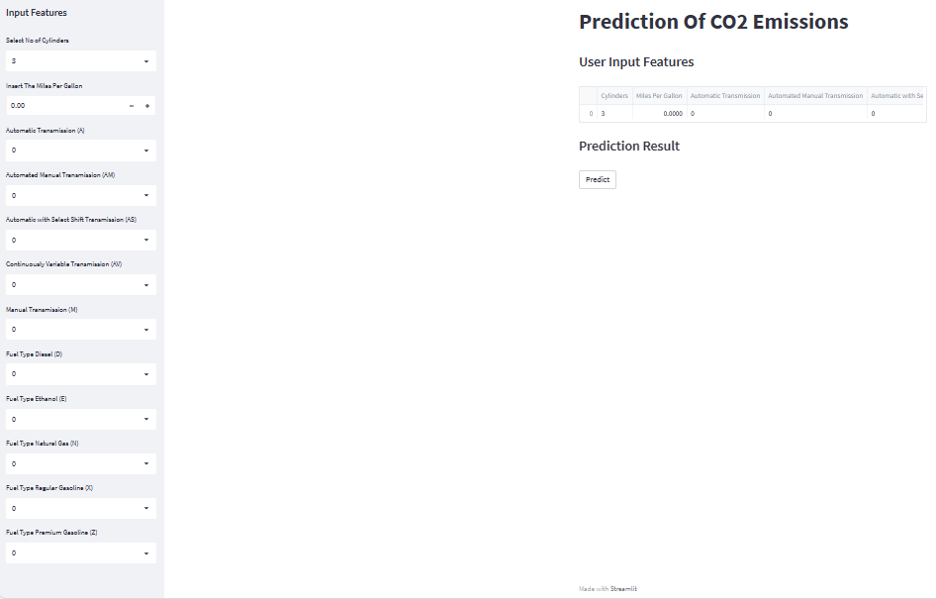
Streamlit App

Slide 14
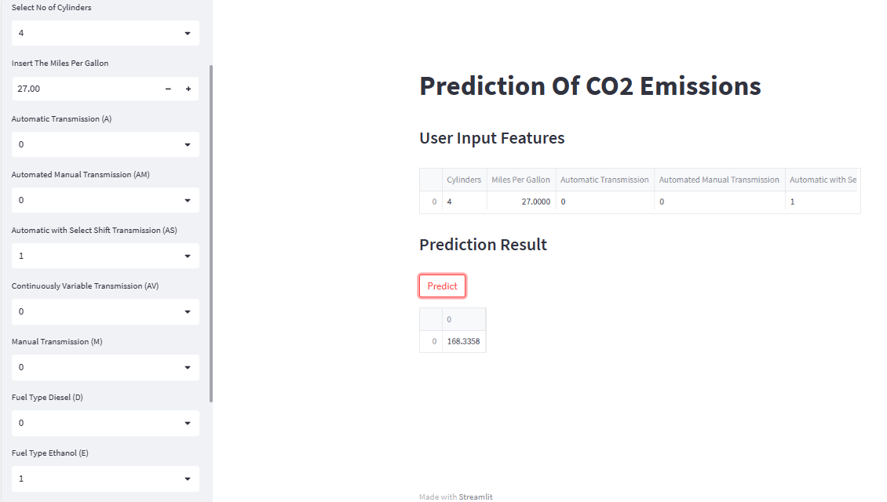
Streamlit App

Slide 15
THANK YOU

